Slide 1
EVALUATION AND IMPLEMENTATION OF VARIOUS BAYESIAN APPROACHES TO MODEL PREDICTIONS OF FUTURE CLIMATE CHANGE
Done By –Saswata Lahiri(RA1911027010001) &
Aagam Shah (RA1911027010015)

Slide 2
ABSTRACT
Climate change is a major environmental issue that affects the entire planet. Accurate and reliable predictions of future climate change are essential to inform policy decisions and to develop effective mitigation and adaptation strategies. Bayesian modeling techniques have been shown to be effective in predicting future climate change by combining different sources of information, including historical data, climate models, and expert knowledge.
This project aims to evaluate and implement various Bayesian approaches to model predictions of future climate change. The project will involve web scraping for data acquisition and preparation, model development using Bayesian methods, model evaluation, and implementation of the models. The project will use different sources of data, including historical climate data, climate models, and expert knowledge. The results of the project will help to improve the accuracy and reliability of climate change predictions and will inform policy decisions and the development of mitigation and adaptation strategies.
The use of web scraping techniques will allow for the acquisition of a large and diverse set of data, enhancing the robustness and accuracy of the models.

Slide 3
INTRODUCTION
It is doubtless that global change has become one the challenges, which encompasses a wide range of human life, including social and economical aspects of human life. Research has indicated that climate change will continue affecting the world as long as proper measures are not taken to protect the environment.
In this line of thought, human activities have been widely blamed for escalating effects of climate change around the world (Hillel & Rosenzweig 2010). Only time will tell whether taming climate change is possible or not possible
The impact of climate change has been felt in every part of the world. According to United Nations Framework Convention on Climate Change (UNFCCC), Asia, Africa and Latin America are among the regions of the world, which have severely been affected by the scourge. In a 2010 survey carried out by Climate Change Secretariat, Africa is under the pressure of climate change and remains vulnerable to these effects.
In this project we aim to predict the future effects on climate change based on certain parameters.

Slide 4
MOTIVATION
A central paradox in human behavior is that people value their health, relationships, and environments yet choose actions that harm them. One explanation for this value-action gap is that evolution shaped human minds to respond to problems faced by our distant ancestors. Consider the disproportionate fear people experience towards spiders compared to cars, even though road injuries are a major cause of death worldwide.
Climate change is an abstract, slow, and distant problem unlike any our ancestors adapted to solve, and therefore humans are poorly equipped for environmentalism. Rather, animals developed biological drives such as reproduction that are partially served in humans through psychological motivations like maintaining positive interpersonal relationships. For example, people over-consume to boost their social status. This leads to two discomfiting claims: behaviors that impact the environment are rarely explained by a conscious motivation towards nature, and conservation efforts will fail if the damaging behavior is easier, cheaper, or better serves social motives. Even deliberate conservation actions could be explained through core social motives and meta-analyses suggest that the most effective interventions harness motives such as belongingness. This is why we chose to address the problem of prediction of climate change.

Slide 5
LITERATURE SURVEY
Patrick Gordan White, A Review of Climate Change Model Predictions and scenario selection for impacts on Asian Aquaculture, December 2013.
Model Choice - In this study, they assessed the performance of three climate models by extracting and comparing their correlation pattern and RMSE(Root Mean Squared Value). CSIRO, HadCM3 and CCMA were able to simulate both rainfall and temperature in Asia Pacific.
Gauge accuracy of model – They used hindcasting which is a way of testing a mathematical model. Known or closely estimated inputs for past events are entered into the model to see how well the output matches the known results.
Most Suitable model - A simplified conceptual model illustrating the linkages among climate, physical habitat conditions, habitat suitability, and Pacific salmon life stages. This conceptual model was used in evaluating the vulnerability of fresh water fish habitats to the effects of climate change in Canada. A similar framework can be developed to assess the projected impacts of climate change on aquatic environments in the Asia Pacific.

Slide 6
L. Mark Berliner, Richard A. Levine and Dennis J. Shea, Bayesian climate change assessment, Manuscript received 20 September 1999, in final form 10 January 2000.
Results - They presented posterior inferences using four subsets of the Jones data corresponding to the time periods. These successively shorter time periods are suggested since climate change trends are anticipated to be increasingly more visible during the latter part of the twentieth century.

Slide 7
Seung-Ki Min , Daniel Simonis and Andreas Hense; Probabilistic climate change predictions applying Bayesian model averaging; June 2007.
Output - the annual time-series of multi-model-weighted ensemble means and their 5–95% percentiles of probabilistic predictions of global mean SATs. It can be seen that the mean values of BF and EM are very similar to each other and larger than AEM where the difference increases in time with a maximum about 0.3 K by the end of the twenty-first century. The 5% percentiles of the three predictions are very close to each other while the 95% percentiles of BF and EM are larger than that of AEM, indicating the broadened PDFs in the upper tail due to the Bayesian weighting.

Slide 8
Habeom kim, Gyoung-Ah Lee & Enrico R. Crema, Bayesian analyses question the role of climate in Chulmun demography, December 2019.
Results - The combination of analyses they presented here provides sufficient evidence to question the narrative of cooling climate being the primary cause of the population decline observed during the Late and Final Chulmun periods. If the cooling climate has been directly responsible for triggering the Chulmun population decline, the population changepoint from positive to negative growth rates would have clearly occurred.

Slide 9
Xihaier Luo, Balasubramanya T. Nadiga, Ji Hwan Park, Yihui Ren, Wei Xu, Shinjae Yoo; A Bayesian Deep Learning Approach to Near-Term Climate Prediction; September 2022
Data - We consider the spatiotemporal variability of sea surface temperature (SST) in the North Atlantic over the last 800 years of the pre-industrial control simulation, or pi Control, a simulation in which external forcing is held fixed, from the Community Earth System Model (CESM) (Danabasoglu et al., 2020) as part of the sixth phase of the Coupled Model Intercomparison Project (CMIP6).These data are publicly available from the CMIP archive at https://esgf-node.llnl.gov/projects/cmip6 and its mirrors. These monthly data display variability on a large range of spatial and temporal scales. The largest spatial variation is in the meridional (i.e., latitudinal) direction, while the largest temporal variation is at the annual timescale and represents the seasonal cycle.

Slide 10
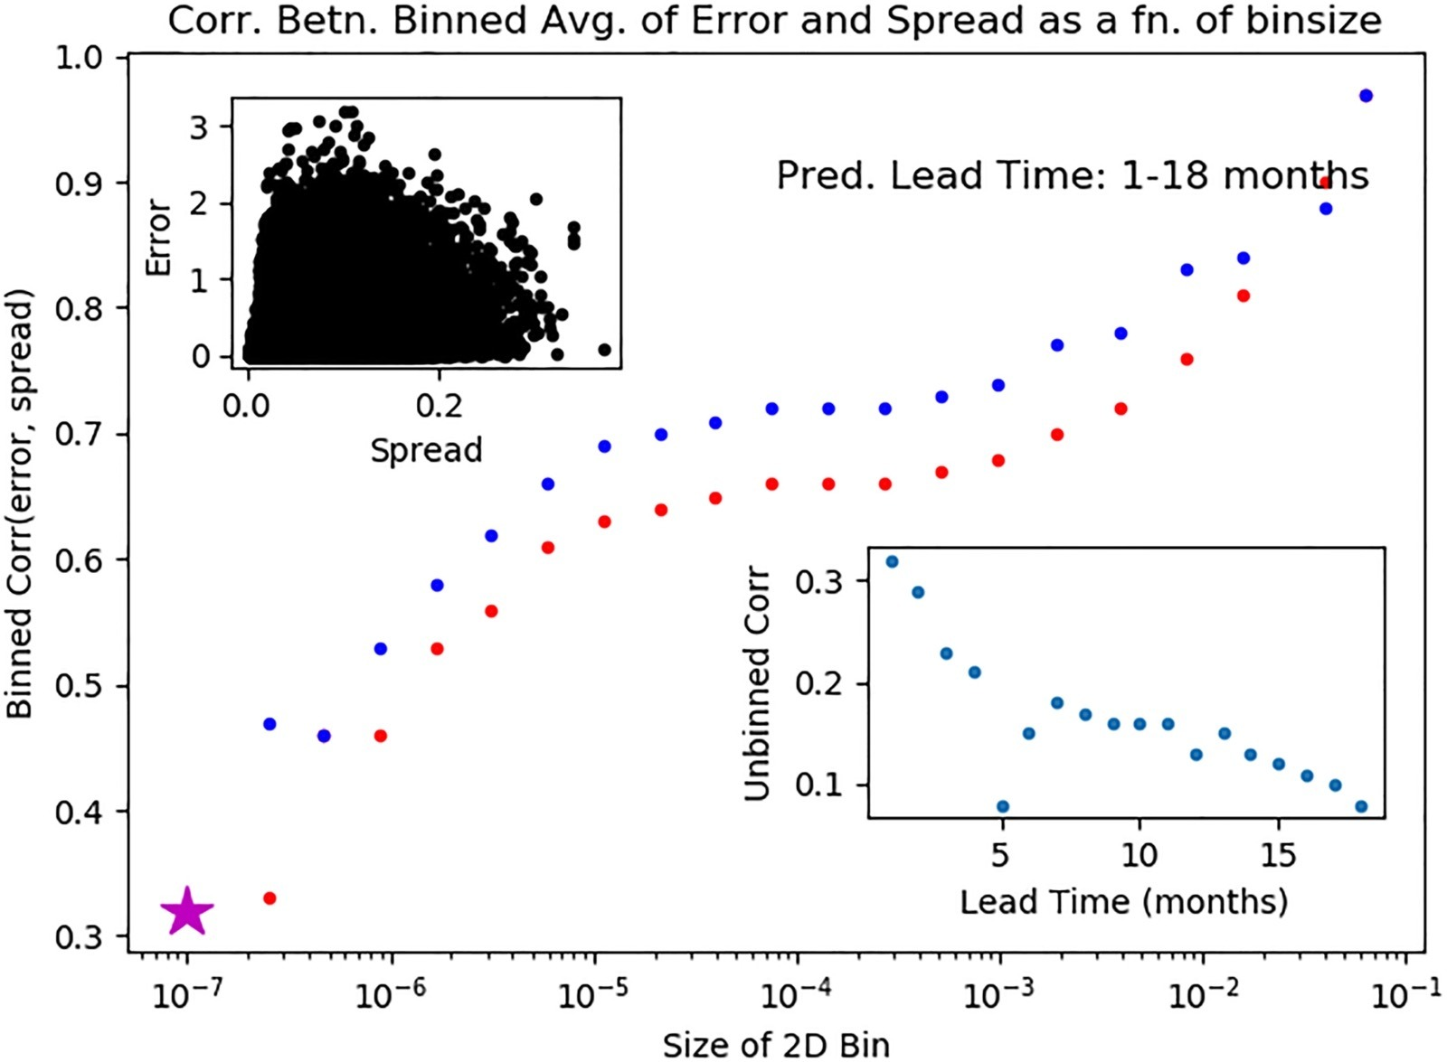
Output - Analysis of the spread-error relationship for Bayesian deep learning (BDL). The inset at the top-left shows a scatter-plot of error versus spread over the full period of prediction (1–18 months lead time). The data is highly dispersed and the Spearman correlation coefficient is a modest 0.33. The inset in the bottom-right shows a plot of the correlation coefficient as a function of prediction lead time. The correlation is seen to decay largely monotonically with increasing lead time. The main panel shows the correlation for a wide range of bin sizes and when outliers are eliminated; the blue and red dots correspond to two different thresholds for determining outliers. A distinct plateau of correlation is seen over a wide range of intermediate bin sizes. This analysis suggests that the uncertainty information from BDL system can be used to estimate prediction error to a certain degree.

Slide 11
Qingyun Duan, Thomas J. Phillips; Bayesian estimation of local signal and noise in multi model simulations of climate change; September 2010
Result- the BMA method is inherently limited by the assumption that all observed and simulated climate variables are Gaussian distributed. Thus, for conducting more comprehensive multivariate investigations, it would be preferable to adopt nonparameteric statistical estimation approaches such as Markov Chain Monte Carlo [e.g., Tebaldi et al., 2005] or MultiObjective Optimization

Slide 12
Benjamin F. Hobbs; Bayesian Methods for Analyzing Climate Change and Water Resource Uncertainties; May 2002.
Conclusions - It provides useful outputs: inferences and recommendations for decisions that are consistent with those inferences. It is based on a comprehensive and coherent framework rooted in normatively appealing assumptions. Compared to alternative paradigms, its concepts are familiar and, as the case studies show, its methods are often practical.

Slide 13
Ali Alinezhad, Alireza Gohari, Saeid Eslamian and Ramin Baghbani, Uncertainty Analysis in Climate Change Projection Using Bayesian Approach
Model Choice - The evaluation of climate change impact on hydrological cycle includes uncertainty. Their study aimed to evaluate the uncertainty of climate change impact on the Zayandeh-Rud Reservoir inflow during the future 2020–2049 period. The outputs of 22 GCM models have been used under the three emission scenarios including RCP2.6, RCP4.5, and RCP8.5. The Bayesian model averaging (BMA) was used as the uncertainty analysis for weighting the outputs of 22 GCM models (precipitation and temperature) based on their ability to simulate baseline 1980–2005 period. Then the time series of equivalent precipitation and temperature were introduced to the hydrological model (i.e. IHACRES) and the output of runoff was estimated under different climate change scenarios.
Approach - They used the upstream sub-basin of the Zayandeh-Rud Reservoir is known as the case study of this paper which is situated between 49° 54ʹ to 50° 45ʹlongitudes and 32° 18ʹ to 33° 12ʹ latitudes. They used Downscaling GCM outputs and simulating runoff with Bayesian Model averaging.

Slide 14
Results - The Root Mean Square Error (RMSE) is here applied to compare the abilities of different global climate models (GCMs) and the BMA method to generate the observed hydro-climatic variables’ time series in the historical 1980-2005 period most of the GCMs showed considerable errors in projection of the observed precipitation in winter and spring months. But, the BCC-CSM1.1(m), FGOALS-g2, GFDL-CM3 and MIROC5 had relatively better abilities to estimate rainfall values in cold seasons. The PDF of annual temperature and precipitation during the baseline and future (after application of BMA) periods are indicated The average of annual temperature showed 0.5 to 1 C increase under different climate change scenarios for the future This increase in temperature can intensify the process of melting snows in the basin. Furthermore, the projected annual rainfall showed a reduction of 13 to 18 percent which will negatively alter the stream flow in the future .
In this study they concluded that, the outputs of 22 GCMs are the climate change impacts on the Zayandeh-Rud Reservoir Inflow for the future 2020-2049 period. To increase the reliability of hydro-climatic projections, the Bayesian Model Averaging was utilized for climate change impact assessment.

Slide 15
J. D. Annam, Recent Developments in Bayesian Estimation of Climate Sensitivity, November 2015.
Result - The subjective Bayesian approach is now widely utilized for estimation of the equilibrium climate sensitivity. Progress has been steady, although even the newest estimates can be seen to have limitations. While estimates based on the recent observational record are increasingly converging to a moderate value with a best estimate rarely far from 2 to 2.5 ◦C, and a range which is confidently bounded between about 1 and 4.5 ◦C (or less), these estimates are themselves conditional on approximations that are now recognized to introduce significant additional uncertainties (and perhaps a bias) into the results. The real climate system is more complex than any model, and the concept of an equilibrium sensitivity may not be precisely definable in the real world. Therefore, there must be a limit to how accurately this parameter can be meaningfully estimated. Nevertheless, there is no reason to presume we have yet reached this limit, and it provides a useful basis for predicting the magnitude of future climate change.

Slide 16
Mohammad Sajjad Khan and Paulin Coulibaly; Assessing Hydrological Impact of climate change with uncertainty estimates :Bayesian neural network approach; April 2010
Output- The objective of this study is to assess whether the Bayesian neural network (BNN) model could be used as an efficient hydrological modeling tool for climate change impact study on river flow and reservoir inflows with uncertainty estimates. The objective is proved by applying the BNN model to river flow and reservoir inflow simulations under climate change scenarios on two watersheds in northeastern Canada. Two GCliMs (CGCM1 and CGCM2) with two greenhouse gas emission scenarios (IPCC IS92a and SRES B2) and a statistical downscaling model (SDSM) are used in the investigation. It is found that the 95% confidence limits of the BNN-simulated mean ensemble flow (i.e., flow obtained by using the mean of 100 ensemble members of the downscaled daily precipitation, and daily maximum and minimum temperatures with CGCM1 IS92a emission scenario) is capable of mostly encompassing all other likely flows corresponding to randomly chosen downscaled meteorological ensemble members with CGCM1 IS92a and CGCM2 SRES B2 scenarios, and also most of the flows simulated by another hydrological model, HBV, with CGCM1 IS92a emission scenario. However, the model showed some deficiency in encompassing peak flows for both the river and reservoir inflow simulations—which warrants further improvement of the current BNN model. HBV-simulated peak flows were also not within the uncertainty bands of the BNN model predictions; a possible reason could be the HBV model error and/or the limitation of the current BNN model.

Slide 17
CHALLENGES AND LIMITATIONS IN EXISTING SYSTEM
The existing models have several limitations and challenges :
The existing models are not flexible Bayesian models can easily incorporate various types of data, including observational data, model outputs and expert knowledge.
Data Limitations: Climate models require large amounts of high-quality data to function effectively. However, much of the data is incomplete or inaccurate, particularly in developing countries where monitoring systems may be inadequate or nonexistent
Complexity: Climate change is an incredibly complex system that involves many different factors, such as atmospheric conditions, ocean currents, and greenhouse gas emissions, etc
Overfitting: Other models can sometimes overfit to the training data, which can result in poor performance on new data. This can be a challenge when dealing with climate data, where small errors can have significant consequences Bayesian approach can help to overcome this problem of overfitting
Probabilistic reasoning: other models are not as capable for providing a probabilistic framework for modeling climate change. Bayesian models allows for the quantification of uncertainty and the ability to update the model as new data becomes available.

Slide 18
OBJECTIVES OF THE PROJECT
Evaluate the performance of various Bayesian modeling techniques in predicting future climate change. This would involve comparing the accuracy and efficiency of different Bayesian models, such as Bayesian networks, hierarchical models, and Bayesian spatiotemporal models.
Explore the use of different types of data in Bayesian climate models, including observational data, model outputs, and expert knowledge. This would involve assessing the advantages and limitations of different data sources and identifying the most effective ways to integrate them into Bayesian models.
Investigate the role of uncertainty in Bayesian climate models, including the quantification of uncertainty and the ability to update the model as new data becomes available. This would involve assessing different methods for modeling uncertainty and identifying best practices.
Develop new Bayesian modeling techniques that address the unique challenges posed by climate change, such as extreme weather events and nonlinear dynamics. This would involve exploring innovative approaches to modeling complex climate systems and developing new methods for incorporating emerging data sources
Overall, the objective of this project is to advance the state of the art in Bayesian modeling for climate change prediction and to identify best practices for implementing Bayesian models for future predictions of climate change

Slide 19
INNOVATION IDEA OF THE PROJECT
Could be to develop a hybrid Bayesian machine learning model for climate change prediction. This would involve combining the strengths of Bayesian modeling with those of machine learning, to create a more accurate and efficient predictive model.
The hybrid model would use Bayesian techniques to model uncertainty and incorporate prior knowledge, while also using machine learning algorithms to identify complex patterns in the data and make more accurate predictions. This would involve developing novel methods for combining Bayesian and machine learning approaches, such as incorporating Bayesian priors into neural networks or using ensemble learning to improve the accuracy of Bayesian models.
This innovation would have several potential benefits. First, it could improve the accuracy of climate change predictions, particularly in complex and dynamic systems where traditional Bayesian models may struggle. Second, it could make climate modeling more efficient, by reducing the computational resources required for Bayesian modeling. Finally, it could improve the interpretability of climate models, by using machine learning techniques to identify patterns in the data and make the model more transparent

Slide 20
SCOPE AND APPLICATION OF THE PROJECT
In terms of scope, the project could cover a wide range of topics related to Bayesian modeling for climate change, including the use of various types of data, the incorporation of expert knowledge, the modeling of uncertainty, and the development of new modeling techniques. The project could also explore the performance of various Bayesian modeling techniques, such as Bayesian networks, hierarchical models, and Bayesian spatiotemporal models.
In terms of application, the project has the potential to be applied in a wide range of fields, including climate science, environmental policy, and public health. For example, the project could be used to develop more accurate and effective climate models for use in climate policy decisions, such as the development of emissions reduction targets and the evaluation of mitigation strategies. The project could also be used to better understand the health impacts of climate change, such as the increased incidence of respiratory diseases or heat-related illnesses.
The project could also have applications in industry, such as in the development of new renewable energy technologies, or in agriculture, where accurate climate predictions are essential for crop planning and risk management.

Slide 21
ARCHITECTURE
Data acquisition and pre -processing
Bayesian modelling Approach
Implementation of Machine learning techniques
Model evaluation
Implementation and communication
Project management

Slide 22
PROPOSED MODULES AND THEIR ALGORITHM DESCRIPTION
Data Acquisition and Preparation: This module will involve web scraping, downloading of existing datasets, and data cleaning to prepare the data for modeling. Algorithmic steps may include parsing and extraction of relevant data from websites, handling missing data, and merging data from different sources.
Bayesian Model Development: This module will involve the development of Bayesian models for climate change prediction. Various approaches such as Bayesian hierarchical models, Markov Chain Monte Carlo (MCMC), Bayesian networks, and Gaussian processes may be used. The algorithmic steps may involve model specification, prior selection, posterior estimation, model fitting, and model validation.
Bayesian Neural Networks: This module will focus specifically on the use of Bayesian neural networks for climate change prediction. Algorithmic steps may involve model architecture design, parameter initialization, model fitting, and model validation.
Model Evaluation: This module will evaluate the performance of the Bayesian models developed in the previous module. Algorithmic steps may include model comparison using statistical metrics such as mean square error, root mean square error, and R-squared, and cross-validation techniques to assess the generalization of the models.

Slide 23
Model Implementation: This module will involve the implementation of the models for climate change prediction. The models may be integrated into web-based applications or decision support systems. Algorithmic steps may involve deploying the models in a production environment, monitoring their performance, and updating the models as new data becomes available.

Slide 24
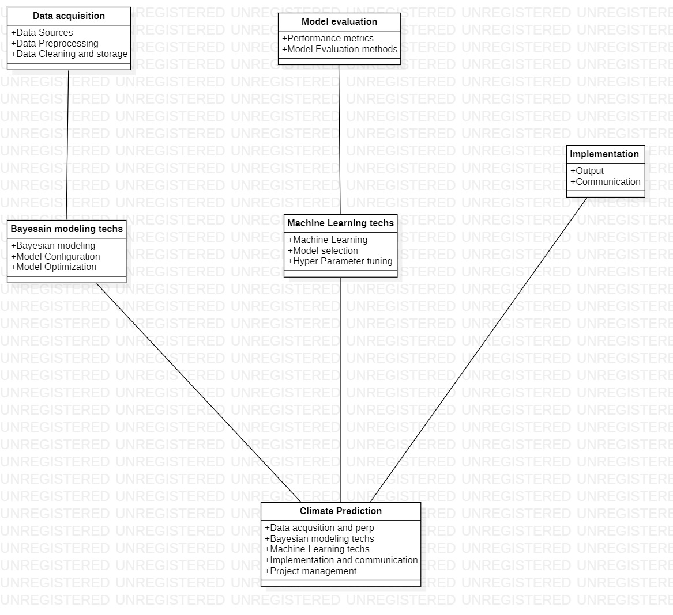
UML DIAGRAMS FOR THE PROPOSED MODULES
In this class diagram, there are six classes representing the major components of the project. The "Data acquisition" class is responsible for acquiring, preprocessing, and storing the relevant data. The "Model evaluation" class evaluates the models' performance using various metrics and methods. The "Implementation and Communication" class is responsible for implementing the models and communicating.
The "Bayesian modeling techniques" and "Machine learning techniques" classes are responsible for applying their respective models to the data.
The "Climate Prediction" class represents the main component of the project and has attributes for all the other components. It is responsible for managing the project and coordinating the actions of the other components.
This class diagram can be used to understand the responsibilities and interactions between the components and can guide the project's implementation.

